Slide 1
Assessing competences in enterprises: Main findings from Cedefop studies
Jens Bjornavold
Brussels 12 may 2017

Slide 2
Sources
1
2
Validation in enterprises
European Inventory
www.cedefop.europa.eu/validation
#ValidationEurope
Notes:
2

Slide 3
VALIDATION
Competence assessment
Performance indicators
Employee appraisal
Validation means a process of confirmation by an authorised body that an individual has acquired learning outcomes measured against a relevant standard
Identification
Documentation
Assessment
Certification
3
#ValidationEurope
#ValidationEurope
Notes:
3

Slide 4
Validation by enterprises
Identify, map out , characterise and evaluate company-based competence validation approaches
Survey of 400 enterprises
20 in-depth case studies
In depth interviews with 29 HR managers in 10 countries
Focus on middle-sized (50-250) and large (250+ ) companies
#ValidationEurope
Notes:
4
Denmark, Finland, France, Germany, Ireland, Lithuania, the Netherlands, Norway, Romania and Spain

Slide 5
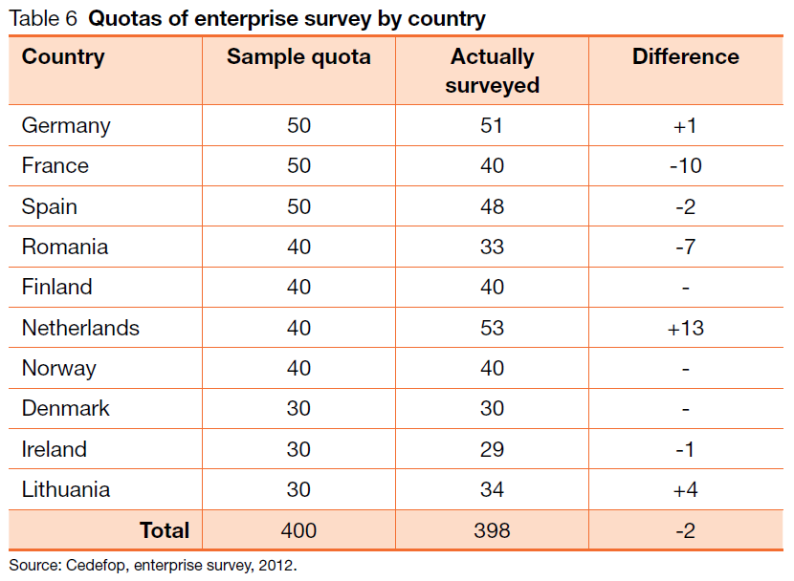
Surveyed enterprises
#ValidationEurope
Notes:
5

Slide 6
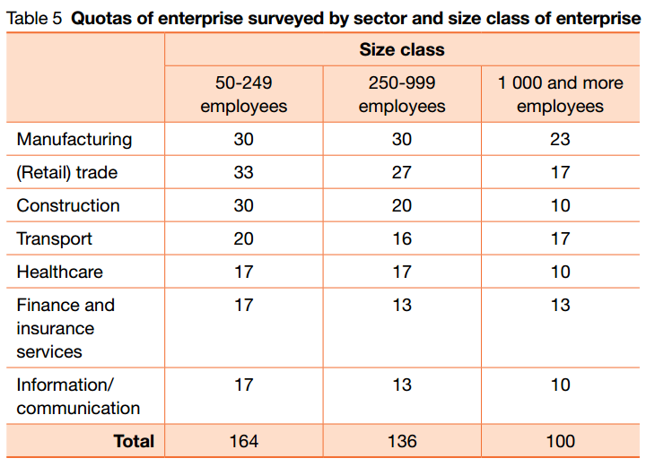
Surveyed enterprises
#ValidationEurope
Notes:
6

Slide 7
Main reasons as referred by companies
Recruitment of new staff
Identification of training needs and development of employees’ skills
Basis for promotions and succession planning
As an integrated part of quality assurance systems
Underpinning restructuring and redundancies
#ValidationEurope
Notes:
7

Slide 8
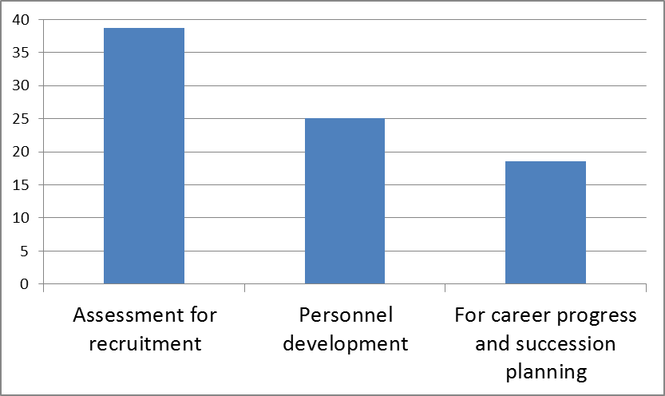
Extensive/Systematisation of competence assessment by purpose
(scale 1 to 4) 4='Very extensive/ systematic"
Source: Cedefop, enterprise survey, 2012
#ValidationEurope
Notes:
8

Slide 9
Who is the targeted for competence asessment?
Competence assessments are predominantly addressing two groups:
Executives and leadership/management
Highly qualified technicians and engineers
To a lesser degree
Sales personnel
Employees in direct contact with customers
Low-skilled and ‘ blue collar’ workers are least exposed to competence assessment

Slide 10
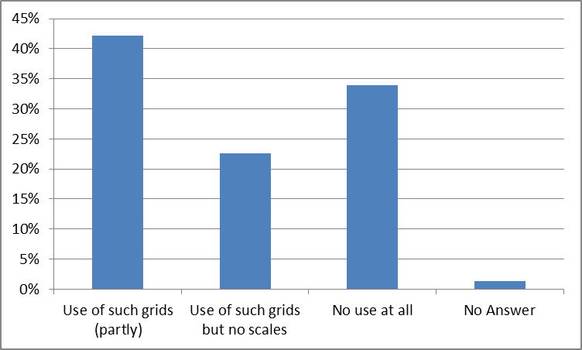
Standarized?
% of enterprises that use a standardised grid or model for competences in employees appraisal

Slide 11
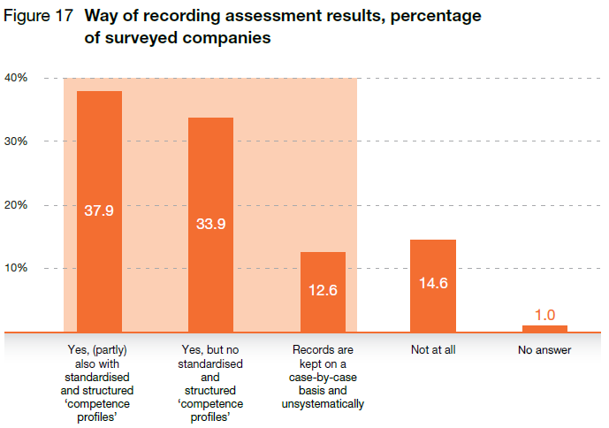
Documentation

Slide 12
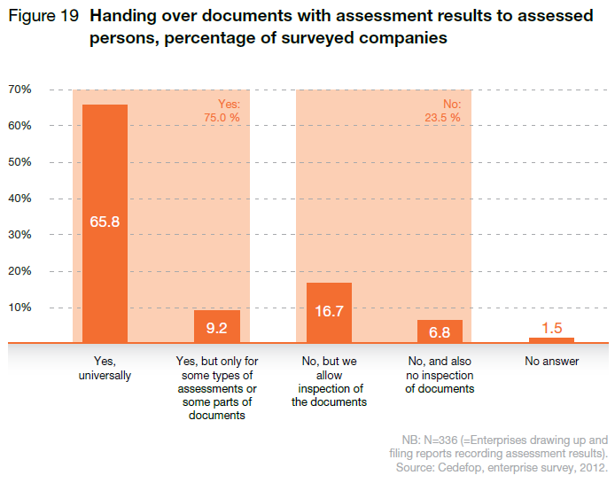
Ownership

Slide 13
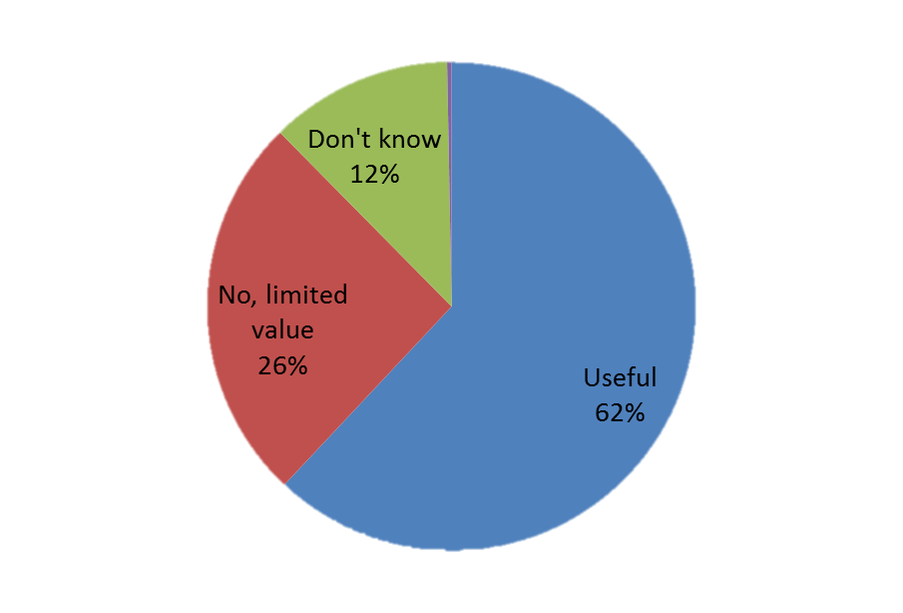
Transferability
Usefulness of results of competence assessment practices
done by other companies, percentage of surveyed companies

Slide 14
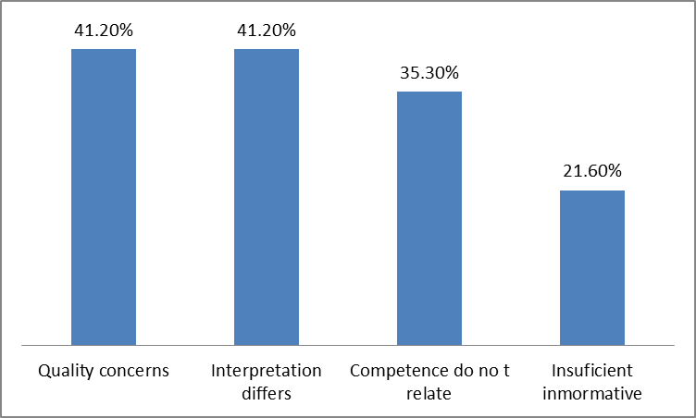
Transferability
Reasons for results of competence assessment practices done by other companies of limited value, percentage of surveyed companies

Slide 15
Key observations regarding competence assessment in companies (I)
The more crucial the position, the more effort is put into assessment
Social and personal skills and competences are especially important, and increasing in importance
Degree of formalisation of competence assessment very much depends on company size
Degree of formalisation depends on sector, health and financial sectors exemplify sectors where competence assessment is common
#ValidationEurope
Notes:
15

Slide 16
key observations regarding competence assessment in companies (II)
Existing competence assessments in companies are predominantly the exclusive property of employers
The outcomes of competence assessment can only to a limited extent be used by individual employees outside the company as part of wider career or lifelong learning strategies
Transferability and portability of the outcomes of competence assessments is a key challenge
#ValidationEurope
Notes:
16

Slide 17
Objectives
The European Inventory on validation of non-formal and informal learning
2005
2004
2008
1
1 – A trusworthy source of information
2
3
2 – Up to date information
4
2010
5
3 - Systematic monitoring of progress
4 - Both a country-specific and a thematic dimension
5 – Work together with the guidelines
2014
2016
2018
Ernesto Villalba
#ValidationEurope
Notes:
17

Slide 18
The European Inventory (2016)
Country reports36 reports (covering 33 countries)
4 Thematic studies
A synthesis of main findings
Validation and OER
Financing validation
Validation in relation to the labor market: The cases of youth and health sector
Monitoring validation
www.cedefop.europa.eu/validation/inventory
#ValidationEurope
Notes:
18

Slide 19
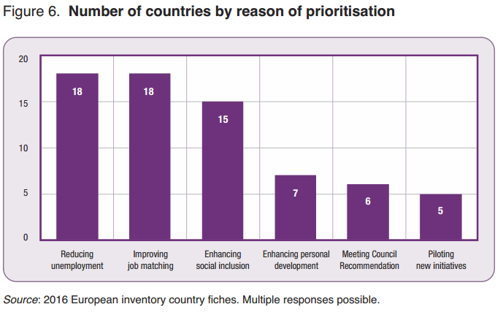
Validation purpose

Slide 20
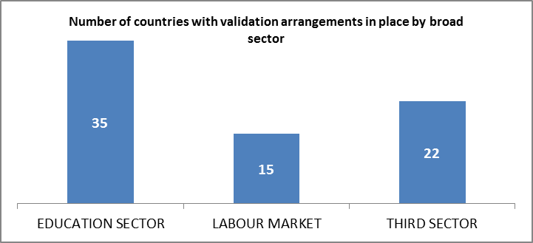
Validation arrangements
Source: European Inventory 2016
Initiatives in which private sector institutions play a central role (alone or in collaboration with public sector institutions)

Slide 21
Questions
Are employers interested in Validation? How do we get them involve?
The coordination of different validation arrangements needs to be improved
Public – private partnership
Within sectors
Similar language and common templates?
Who pays? Is it an issue of cost?
Wages increase after validation?
#ValidationEurope
Notes:
21

Slide 22
Thank you for your attention!
http://www.cedefop.europa.eu/validation

